Slide 1
Business Collaboration Framework
Jim Clark
Microsoft Corporation

Slide 2
Objectives
What is the BCF?
Industry Impact
BCF Overview
ISO Work Initiatives

Slide 3
BCF Overview
BCF Conceptual Overview
Success Factors & Architectural Principles
Architecture Structure

Slide 4
Business Collaboration Framework (BCF).
Result of 12 years of continuing evolution in which key concepts and artifacts which were developed in concert with various industry and public standard organizations.
Set of architectures, methodologies, patterns and business semantics defined in accordance with certain business reference models and ontologies.
Provides for the reification of process and information definition from one view or perspective to the next.
Donated to the United Nations and to the public domain in October of 2000 and forms the basis of the UN/CEFACT Modeling Methodology (UMM).
Currently being adopted by the ISO as part of Open-edi standard
Notes:
set of architectures, patterns and business semantics defined in accordance with certain business reference models and ontologies.
This framework provides for the reification of process and information definition from one view or perspective to the next without the loss of semantic or computational integrity.
The Business Collaboration Frame was donated to the United Nations and to the public domain in October of 2000 and forms the basis of the UN/CEFACT Modeling Methodology (UMM).
Provides for the reification of process and information definition from one view or perspective to the next without the loss of semantic or computational integrity.

Slide 5
Reference Ontologies
Business Domain View
  ISO/IEC IS 14662 Information Technologies - Open-edi reference model
  ISO/IEC 15944, Business Agreements Semantic Descriptive Techniques
Business Requirements View
  “The REA Accounting Model: A Generalized Framework for Accounting Systems in a Shared Data Environment”
  ISO/IEC 15944, Business Agreements Semantic Descriptive Techniques
Business Transaction View
  The Commercial use of Electronic Data Interchange, Section of Business Law American Bar Association, A report and model trading partner agreement, http://www.abanet.org/buslaw/catalog/5070258.html
  PART 2 UNIFORM RULES OF CONDUCT FOR INTERCHANGE OF TRADE DATA BY TELETRANSMISSION (UNCID), CHAPTER 2 - Text of the Uniform Rules of Conduct, http://www.unece.org/trade/untdid/texts/d220_d.htm
Business Service View
  PART 2 UNIFORM RULES OF CONDUCT FOR INTERCHANGE OF TRADE DATA BY TELETRANSMISSION (UNCID), CHAPTER 2 - Text of the Uniform Rules of Conduct, http://www.unece.org/trade/untdid/texts/d220_d.htm
  UN/ECE RECOMMENDATION No.26, THE COMMERCIAL USE OF INTERCHANGE AGREEMENTS FOR ELECTRONIC DATA INTERCHANGE, http://www.unece.org/trade/untdid/texts/d240_d.htm

Slide 6



















Current Industry Impact
MOU
Aligned
With
MOU
Adopted &
Approved By
Formally Adopted
Formally Adopted
BCF
Reviewing for
Adoption
Embraces/Uses
Reviewing for
Adoption
Subset Of

Slide 7
Four Critical Success Factors
Facilitate a structure and environment that permits business to conduct business that is familiar and trusted – a “safe harbor”
Conduct of business does not require a level of sophistication beyond the skill set of the normal business person – convenient
Conduct of business is profitable – reduces cost or increases opportunities (execution)

Slide 8
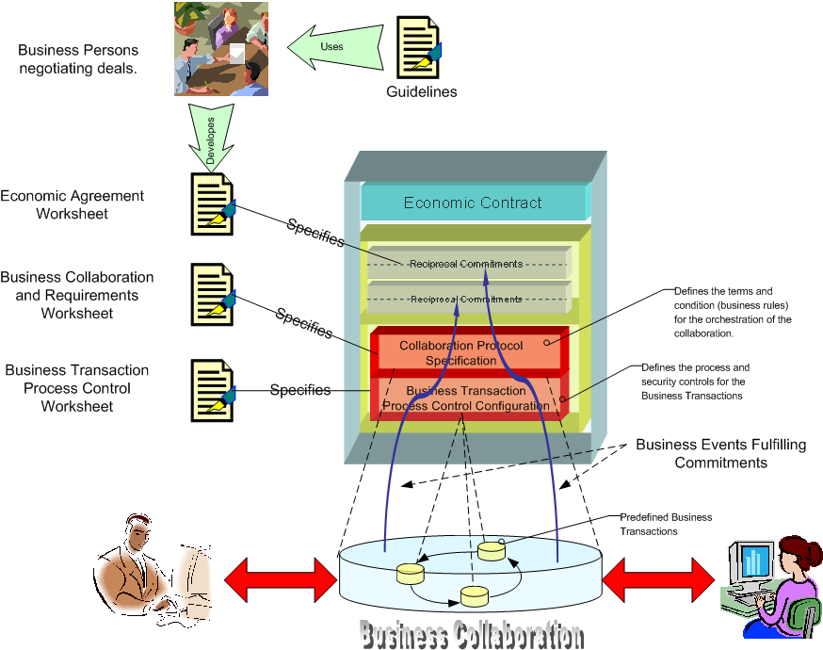
Economic Solution (Model) for e-Business

Slide 9
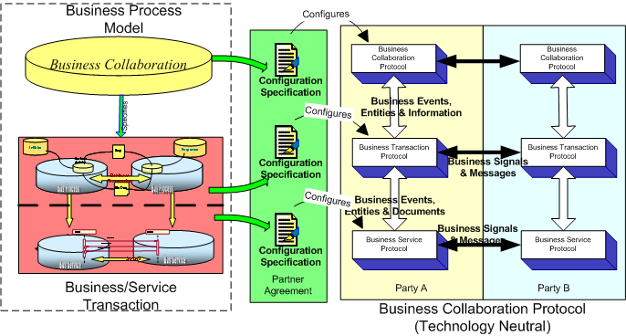

Slide 10
Business Transaction & Service View
The Business Transaction View is a specification of a business transaction according to 6 predefined, legally binding patterns.
Business Transactions View
Logical Process
Initiator
Responder
Resp
Business
Activity
Business Transaction
Bus Process
Biz Doc
Bus Process
The Business Service View is an explicit specification of business process interactions according to the type of transaction, type of role, security and timing parameters. The set of interactions is derived from the BT according to the system requirements.
OriginatingService
:
RespondingService
:
Business Service View
1. request(BusinessAction)
1.1. signal(ReceiptAcknowledgement)
1.2. signal(AcceptanceAcknowledgement)
Bus Service
Bus Service
  System
The Implementation View is a specification of a business interaction according to these selected technology and protocol.
Technology
Transport
Implementation View

Slide 11
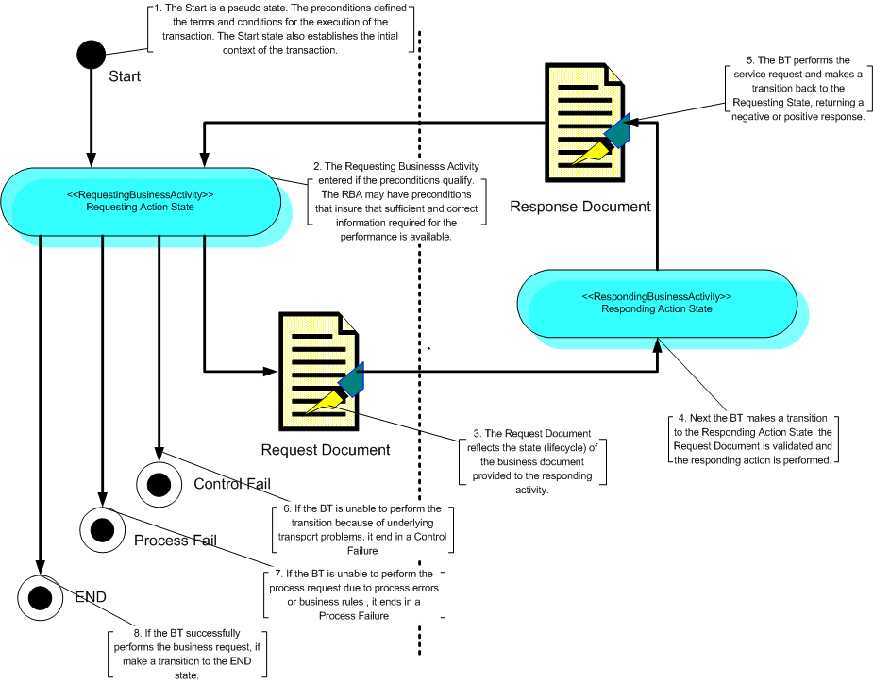
Business Transaction View

Slide 12
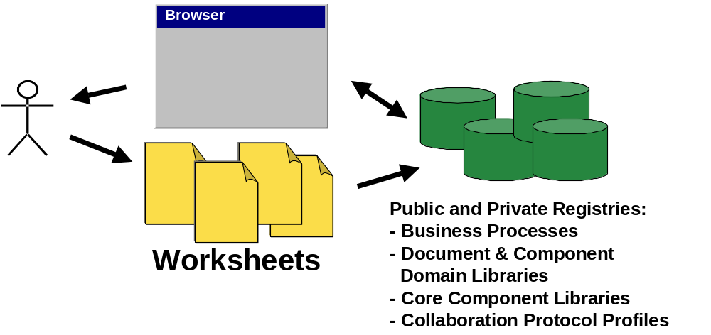
Worksheets and Templates
Templates provide simplification and convenience
Notes:
Typically only tax lawyers and politicians know the tax code and just as typically only business process analyst, architects and developers will know the BCF. However, people file their taxes everyday unassisted. Their tax base may be simple enough that they only need to file a simple return with little detail, or they may have a software program that has built in guidelines that allows the taxpayer to fill in a simple worksheet and be confident that his filing is a accurate as reasonably possible. The following table illustrates this concept of simplification.

Slide 13
US Tax Code Analogy
Just as it unlikely that those who file tax returns do not know the entire US Tax Code, it is likely very few will be fully versed with the BCF.
BCF Artifact | United States Internal Revenue Service (IRS) Tax System
Business Process Collaboration Metamodel, Architecture and Modeling Methodology. | Entire tax code
Worksheets and Templates | IRS Forms
Methodology Guidelines | IRS Instruction Booklets
Business Process Editor Tool Suite Repository of Business Process Specifications, Core Components, etc. | Something like Microsoft Money and other software packages for preparing personal or business tax forms where these packages would have on-line access/search of all your tax and tax related records and the Tax code.

Slide 14
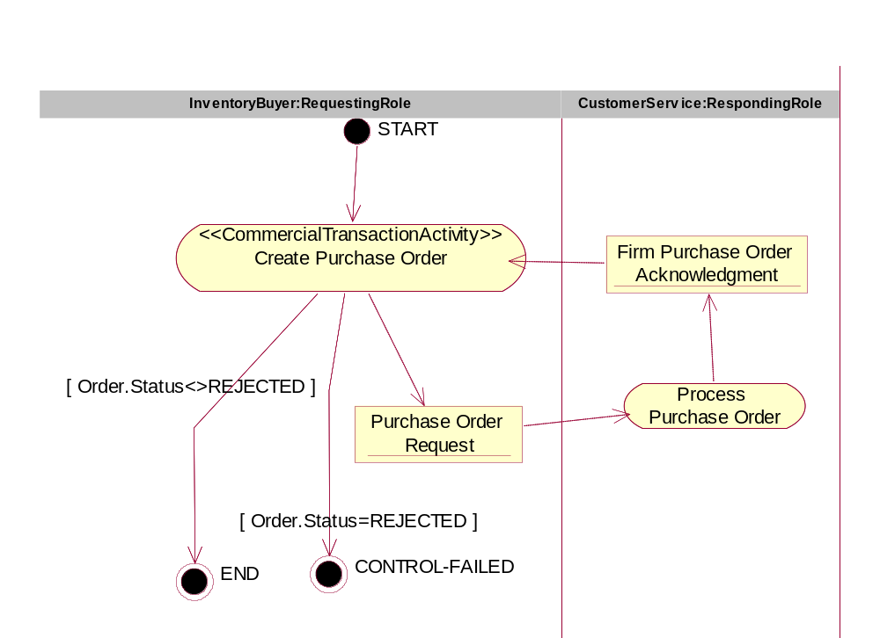
BTV Template
Example
Figure Error! No text of specified style in document.‑21, <<BusinessTransaction>> PurchaseOrderRequest
Form: Business Transaction Transition Table
Form Id | BTTT-8.4-Create-Vendor-Purchase-Order
From Activity | From Role | Document | To Activity | To Role | Guard Condition
START | N/A | N/A | Create Purchase Order | InventoryBuyer | NONE
Create Purchase Order | InventoryBuyer | Purchase Order Request | Process Purchase Order | CustomerService | NONE
Process Purchase Order | CustomerService | Firm Purchase Order Acknowledgement | Create Purchase Order | InventoryBuyer | NONE
Create Purchase Order | InventoryBuyer | N/A | END | N/A | Order.Status<>REJECTED
Create Purchase Order | InventoryBuyer | N/A | CONTROL-FAILED | N/A | Order.Status=REJECTED

Slide 15
Architectural Principles
(Prescription, Precision & Reification)
Prescriptive methodology yields predictable results
Uniformity of notation and precision of semantics provide concise and unambiguous business process definitions
Reification provides the rigor and precision necessary for high-fidelity transformation between business definitions and technology definitions – no loss of semantics or context
Technology and Protocol unbiased is the key to easy adaptation and shared solutions.

Slide 16
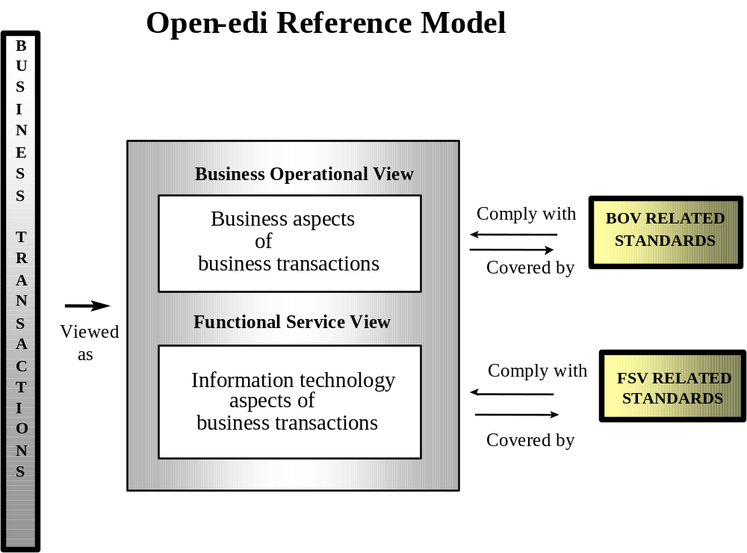

Slide 17
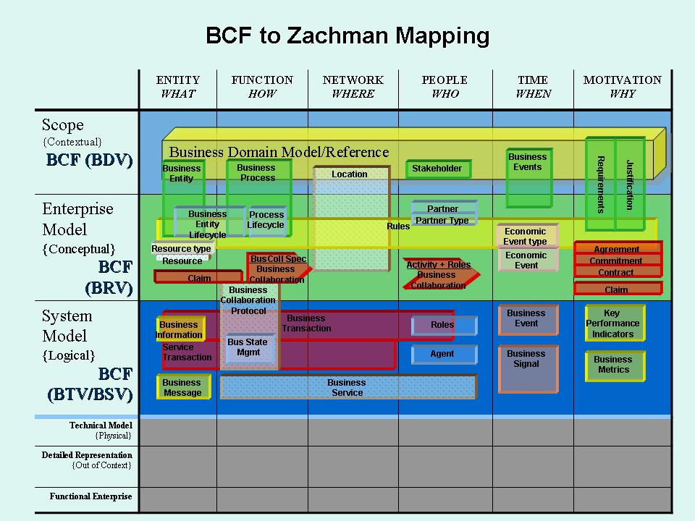
Technology Specific Implementation

Slide 18
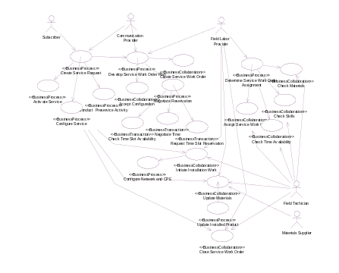
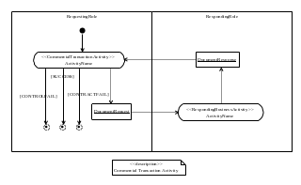
Architectural Structure
Business Domain View
Business Requirements
Business Transaction
Business Service View
Syntax & Semantic Rules
Grammar
Metamodel
View Metamodel
View Metamodel
Metamodel
Transformation Rules
UML Metamodel
Implementation Framework
(from Logical View)
View Metamodel
MetaModel
Defined According To
Used By
Process Areas
Business Domain View
Industry Domain Experts
Business Domain Map
Business
Ontology
Business Areas
Business Operations Map
Business Processes
Reification
Business Process View
Economic
Ontology
Business Process View
Business Persons
Logical Process
Reification
Business
Transaction
Ontology
Business Transaction/Service View
Business Analyst & Developers
Patterns

Slide 19
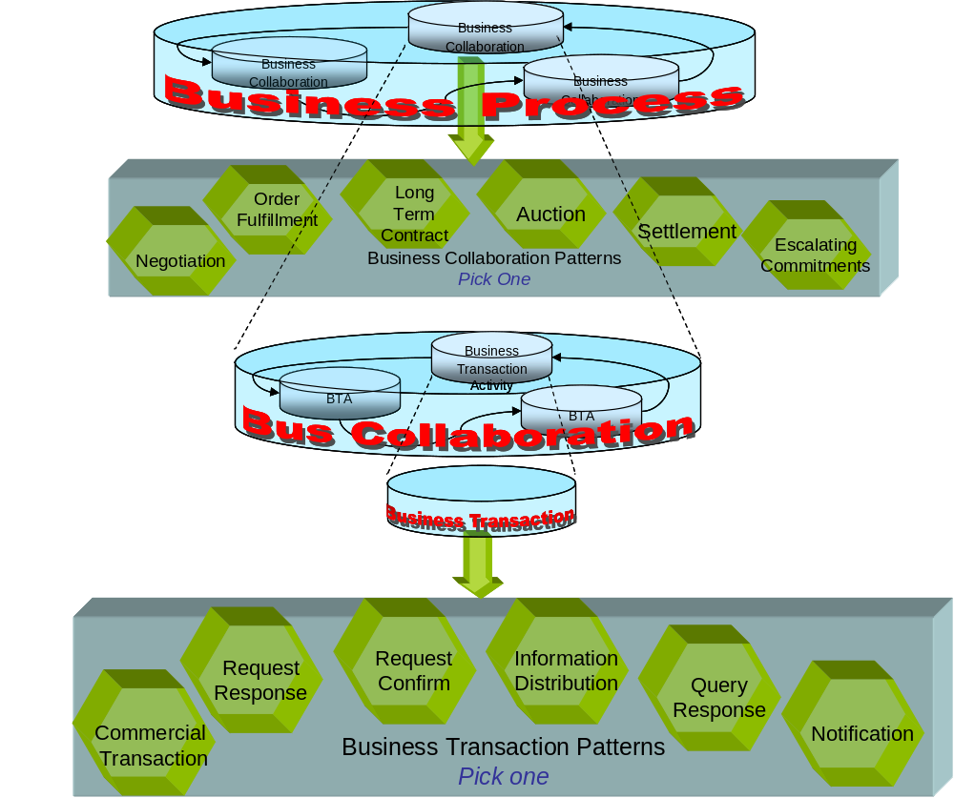
Pattern Framework

Slide 20
Patterns
Patterns are reusable, generalized business process abstractions that can be applied to many domains.
The business transaction patterns are:
  Commercial Transaction
    used to model the “offer and acceptance” business transaction process that results in a residual obligation between both parties to fulfill the terms of the contract
  Query/Response
    used to query for information that a responding partner already has e.g. against a fixed data set that resides in a database
  Request/Response
    used for business contracts when an initiating partner requests information that a responding partner already has and when the request for business information requires a complex interdependent set of results
  Request/Confirm
    used for business contracts where an initiating partner requests confirmation about their status with respect to previously established contracts or with respect to a responding partner’s business rules
  Information Distribution
    used to model an informal information exchange business transaction that therefore has no non-repudiation requirements
  Notification
    used to model a formal information exchange business transaction that therefore has non-repudiation requirements

Slide 21
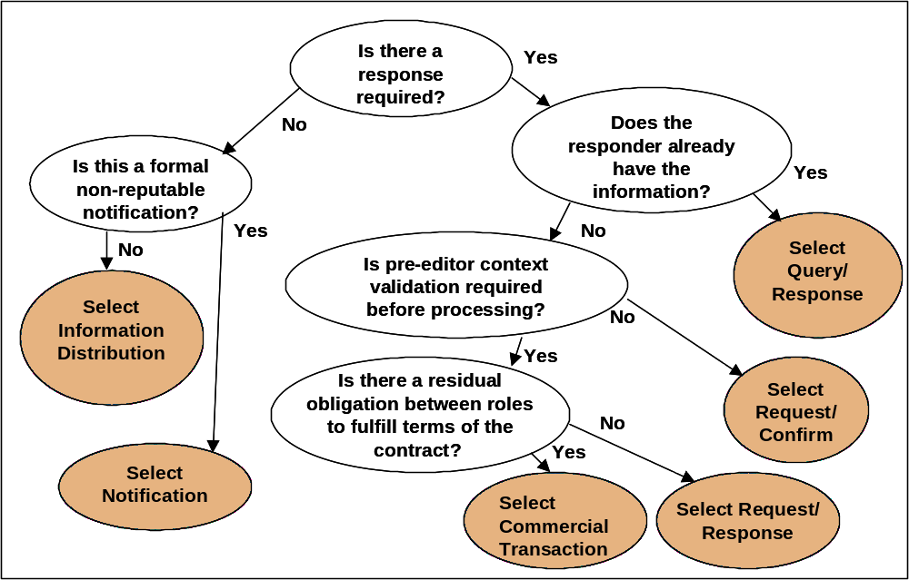
Example Decision Tree

Slide 22
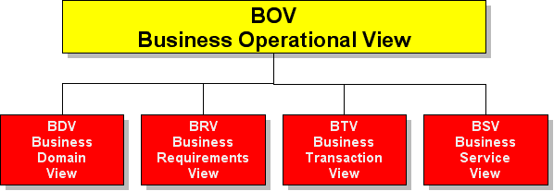
BCF Detailed Review
IFV
Implementation
Framework
View

Slide 23
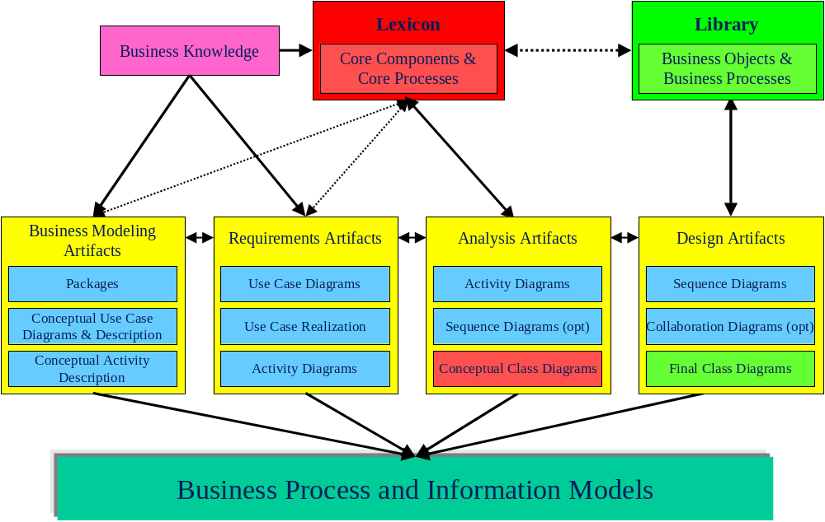
BCF Structure

Slide 24
Meta-Model Architecture
Model Elements
Syntax
Semantics
  Name
  Base type
  Properties
  relationships
  constraints
  well formedness rules
Model Management
Syntax
Semantics
  elements
  property values
  relationships
  constraints
  well formedness rules
Notes:
Model Elements Abstract Syntax
Each modeling element is defined by its base type and properties. Each modeling element becomes a UML stereotype that is used during business process modeling. Tag-value pairs are used to record the values of the properties.
Model Elements Semantics
The second perspective defines the associations and relationships among the elements already defined in (1). These associations or relationships define the semantics of modeling elements.
Model Management Syntax
The third perspective defines the set of modeling elements that are required or available for use in the business model. This provides for the structure or syntax of the model.
Model Management Semantics
As the second perspective provides for the semantics of individual modelling elements, the final perspective (4) of the meta-model also defines or constrains the semantics of the modelling elements as they are used within the model. Associations or relationships define the semantics of modelling elements.

Slide 25
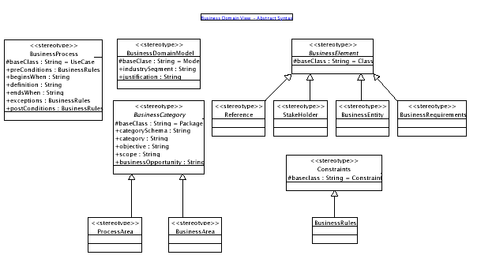
BDV Syntax

Slide 26
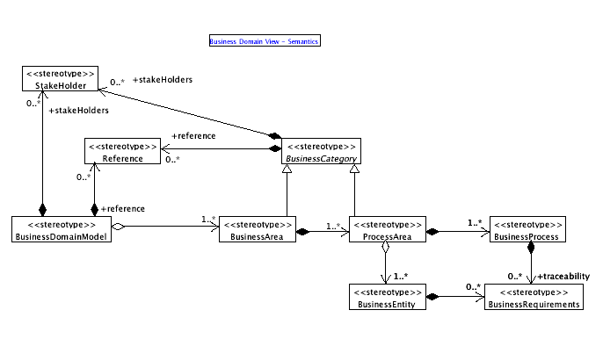
BDV - Semantics

Slide 27
BDV Artifacts and Capabilities
Business Domain Ontologies and Taxonomies
Business Process Maps (BA, PA, Proc)
BDV templates and guidelines
Facilitates Business Process Identification
Facilitates Business Process Gap Analysis (integration & migration)
Examples:
  Microsoft Module Map
  ETOM
  SCOR

Slide 28
Business Domain View
The BDV is an organizational view of the Business Areas and Process Areas as defined by a domain taxonomy.
BDM
• Business Area
• Process Area
• Process(es)
• Categorization/Classification Schema (Taxonomy or Ontology)
Process Areas
Business Domain Map
Business Areas
Business Operations Map
Business Processes

Slide 29
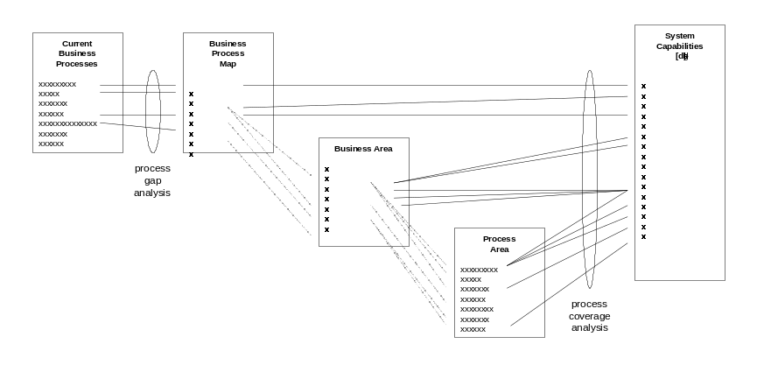
Gap Analysis Using Business Process Maps
A major benefit of a business process map is its usefulness in performing various types of “process gap analysis”.
Process Categorization
  To be useful, processes are carefully categorized so that appropriate views can be derived from them.
    by operation (the part of the business it addresses)
    by role (the type of goal it addresses)
    by level of abstraction (how general or specific it is)
Notes:
First, the map can be used in Process Gap Analysis to increase awareness of how business processes (current or hypothetical) meet underlying business needs. This can be used by the business community to augment other types of process analysis (e.g., traditional or collaborative workflow[1]).
Second, the map can be used to compare the capabilities of any new or existing business system to verify its degree of coverage of business need. Process Coverage Analysis (and it cousin, Requirements Traceability) reveal how well solutions and implementations fulfill committed goals.
For each type of gap analysis desired, a separate “capabilities matrix” is created to map the process-to-process or process-to-capability relationships. The exact form of each gap analysis is driven by the specific solution sought.
Additionally, the high-level processes can be scoped and packaged into subsets (Business and Process Areas) that represent an agreement between business and solution providers about specific goals to be accomplished. Besides validating a solution’s completeness, gap analysis can also points to areas where the process map itself may be incomplete or unclear.
[1] Traditional workflow is based on assembly line or linear process models. Collaborative workflow is based on multiple path or event-driven process models.

Slide 30
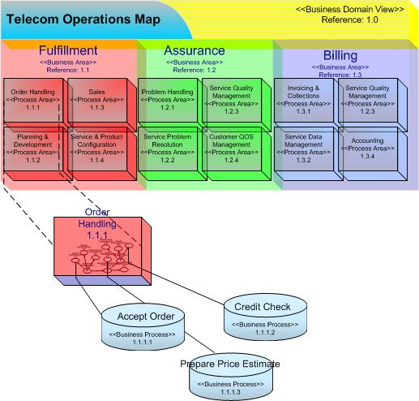
TMForum’s TOM

Slide 31
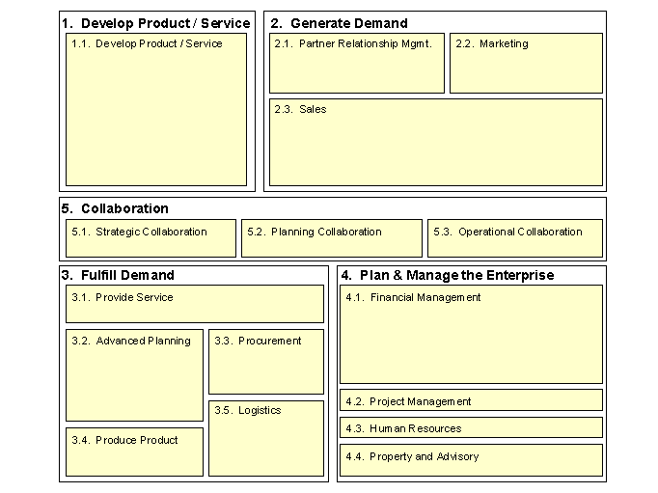
Microsoft’s Module Map

Slide 32
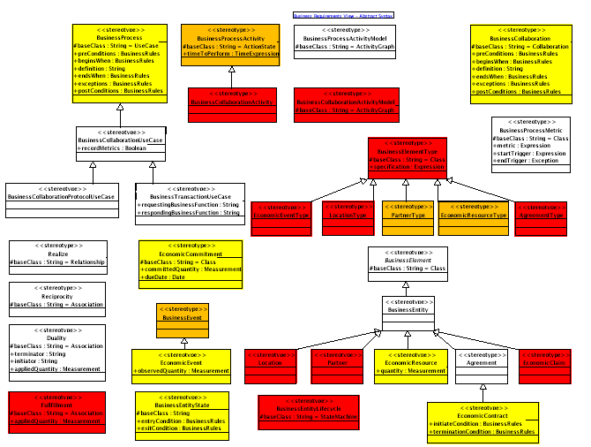
BRV Syntax

Slide 33
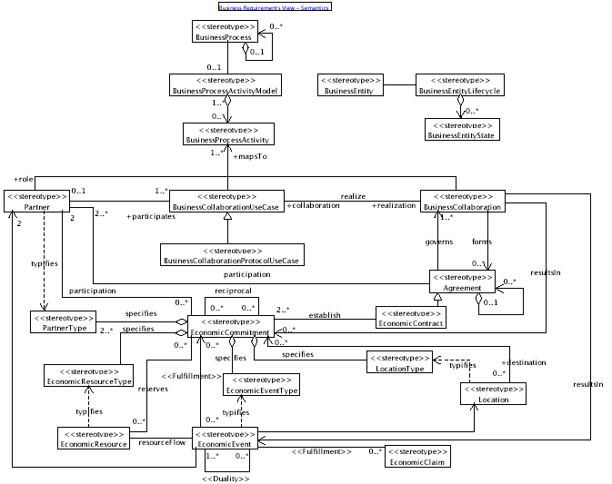
BRV Semantics

Slide 34
Business Requirements/Process View
Business Domain
Business Processes
The Business Requirement View is a specification view of Business Processes defined as use cases, requirements and collaborations. Defines the choreography of Business Transactions. Defines the Economic Resources, Economic Events and the Economic Agents.
BRV Artifacts
Business Process(es)
Business Collaboration, Business Objects
Economic Agreements & Contracts
Business Transaction
Business Transaction
Business Transaction
Business Collaboration
Business Requirements View
Business Transaction View

Slide 35
BRV Artifacts and Capabilities
Artifacts:
  Business Processes, Business Goals & Objectives
  Business Collaboration Workflow, Business Objects, Business Process & State Alignment
  Economic Resources, Agents, Agreements & Contracts
  Predefined patterns, templates and guidelines.
  REA Ontology (AAA)
  Business Event Driven
Examples:
  Halifax (not BCF), Navision (BCF), UCC CPFR (migrating to BCF)
  ITG RosettaNet (Dell) project
  Boeing Global Procurement Project
  DLA – RF Tracking Project
  SIRE Project (possible)

Slide 36
REA (Resource-Event-Agent)
The REA (Resource-Event-Agent) ontology is a specification of the declarative semantics involved in a business collaboration (or more generally in a business process).
The theory behind REA comes from the field of microeconomics with specific ties in many instances to the use of economic definitions in the practice of building enterprise-wide information systems.
REA ontology definitions are applied to the collaborative space between enterprises where market exchanges occur in closely synchronized fashion among two or more trading partners.
Economic Resource
COOKIES
Economic Agent
SHIPMENT
ELMO
Economic Event
Economic Agent
cookie
monster
INITIATING
duality
RESPONDING
Economic Agent
ELMO
Economic Event
Economic Resource
PAYMENT
Economic Agent
CASH
cookie
monster
business process

Slide 37
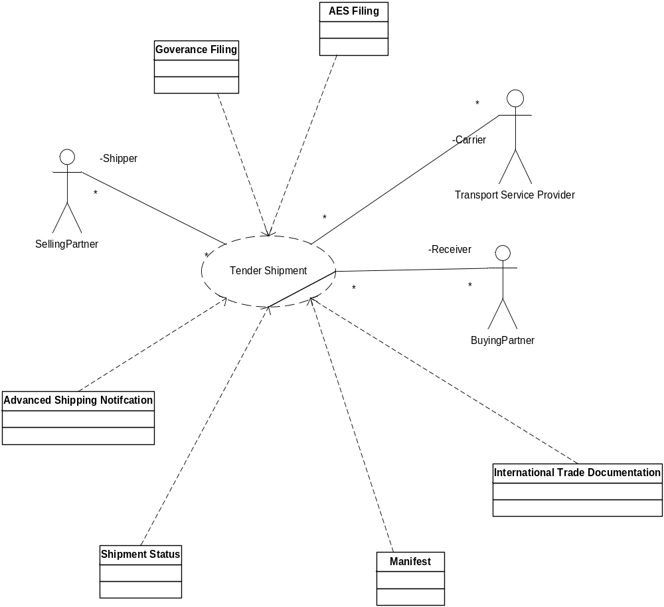
Process Component Specification (Business Collaboration)

Slide 38
BTV/BSV Artifacts and Capabilities
Legally binding Business Transactions (ABA evidentiary requirements)
6 predefined BT patterns, templates and guidelines.
24 predefined ST patterns, templates and guidelines.
Business Transaction State Management
Generalized Process and Control exceptions
Examples:
  RosettaNet Pips (BTV/BSV)
  XML – EDI (X12, BSV)

Slide 39
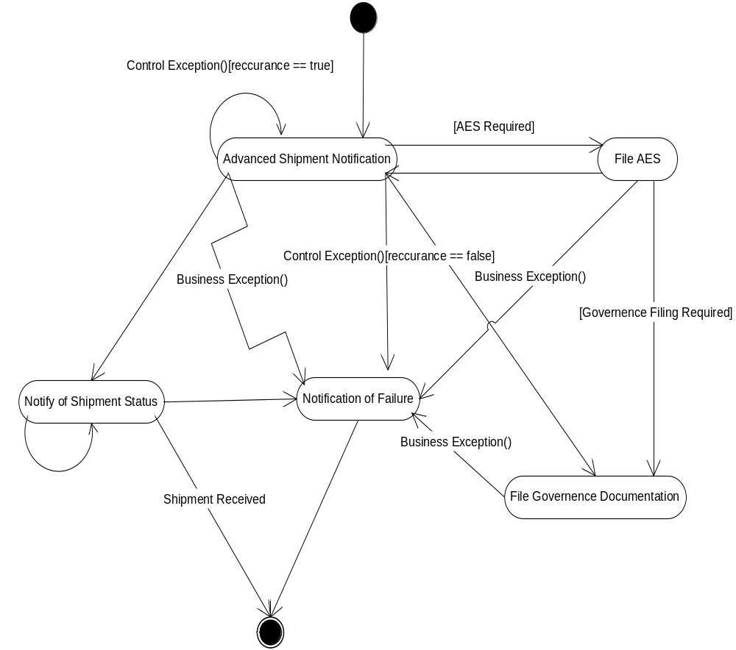
Business Collaboration

Slide 40
Business Transaction & Service View
The Business Transaction View is a specification of a business transaction according to 6 predefined, legally binding patterns.
Business Transactions View
Logical Process
Initiator
Responder
Resp
Business
Activity
Business Transaction
Bus Process
Biz Doc
Bus Process
The Business Service View is an explicit specification of business process interactions according to the type of transaction, type of role, security and timing parameters. The set of interactions is derived from the BT according to the system requirements.
OriginatingService
:
RespondingService
:
Business Service View
1. request(BusinessAction)
1.1. signal(ReceiptAcknowledgement)
1.2. signal(AcceptanceAcknowledgement)
Bus Service
Bus Service
  System
The Implementation View is a specification of a business interaction according to these selected technology and protocol.
Technology
Transport
Implementation View

Slide 41
Business Transaction View

Slide 42
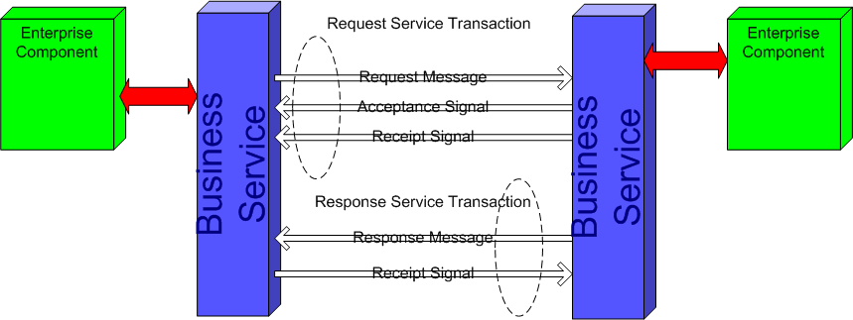
Business Service View

Slide 43
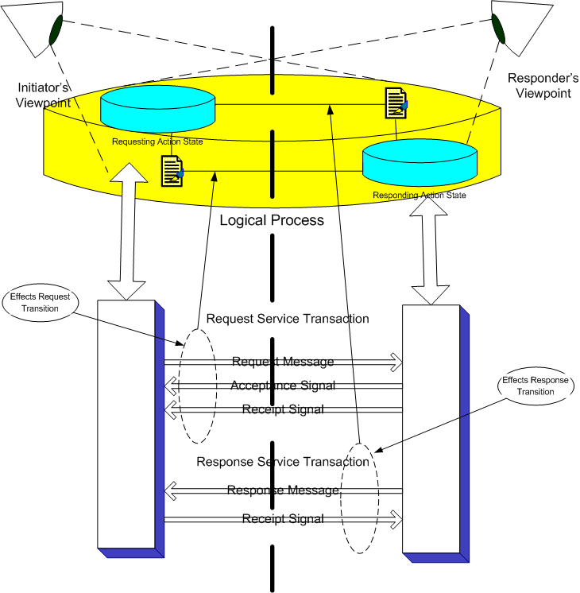
BTV – BSV Reification

Slide 44
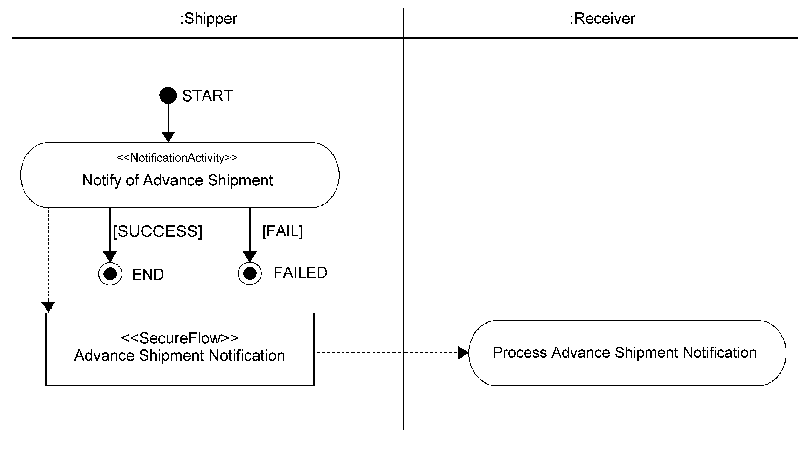
BTV Example

Slide 45
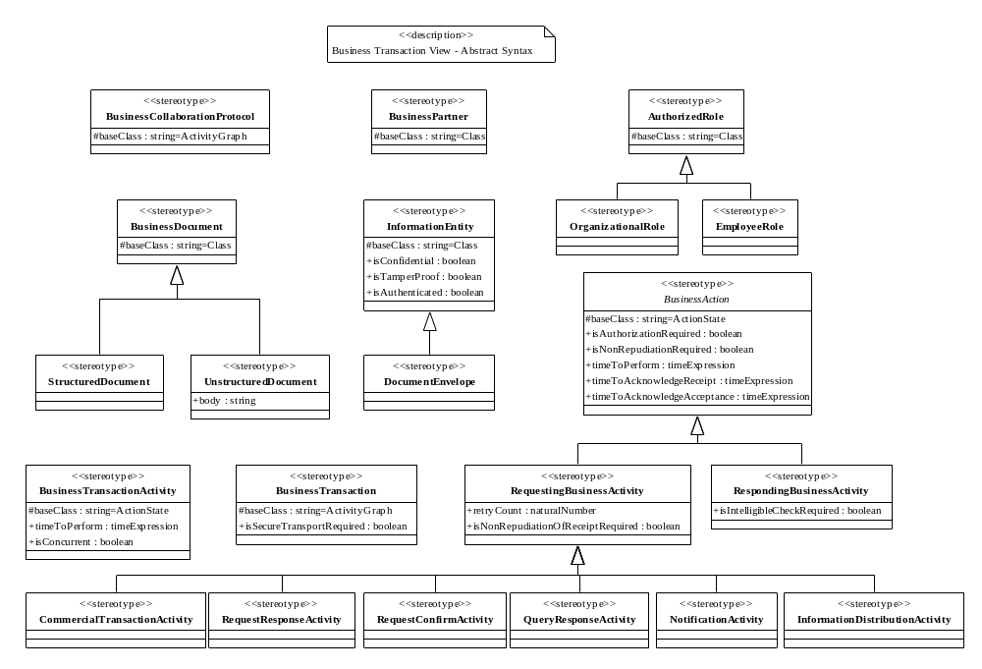
BTV Syntax

Slide 46
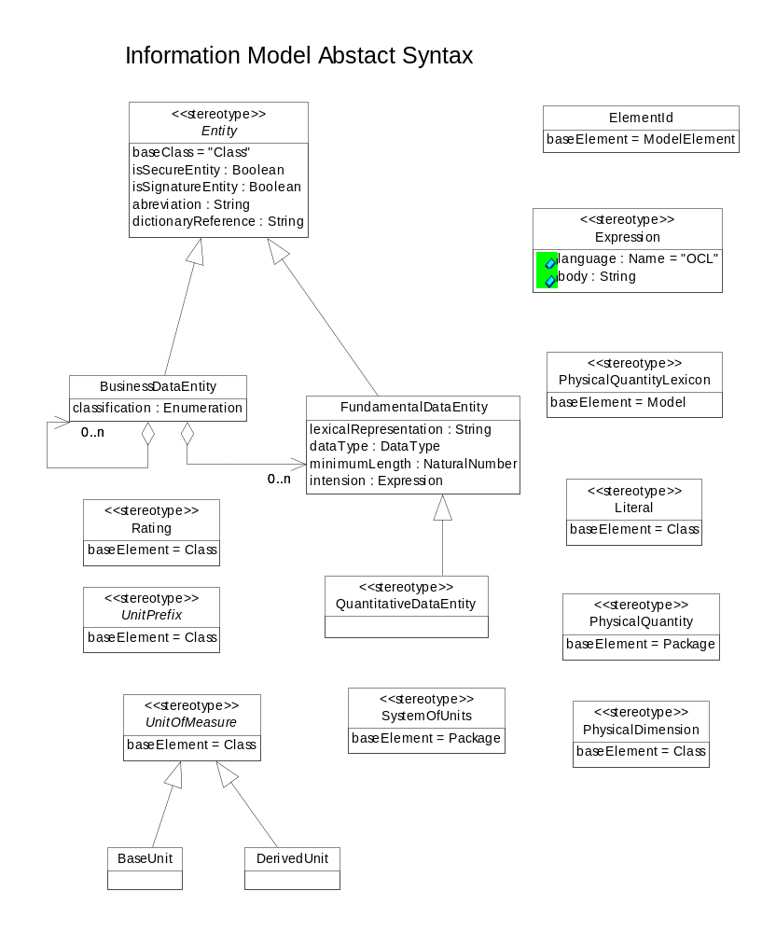

Slide 47
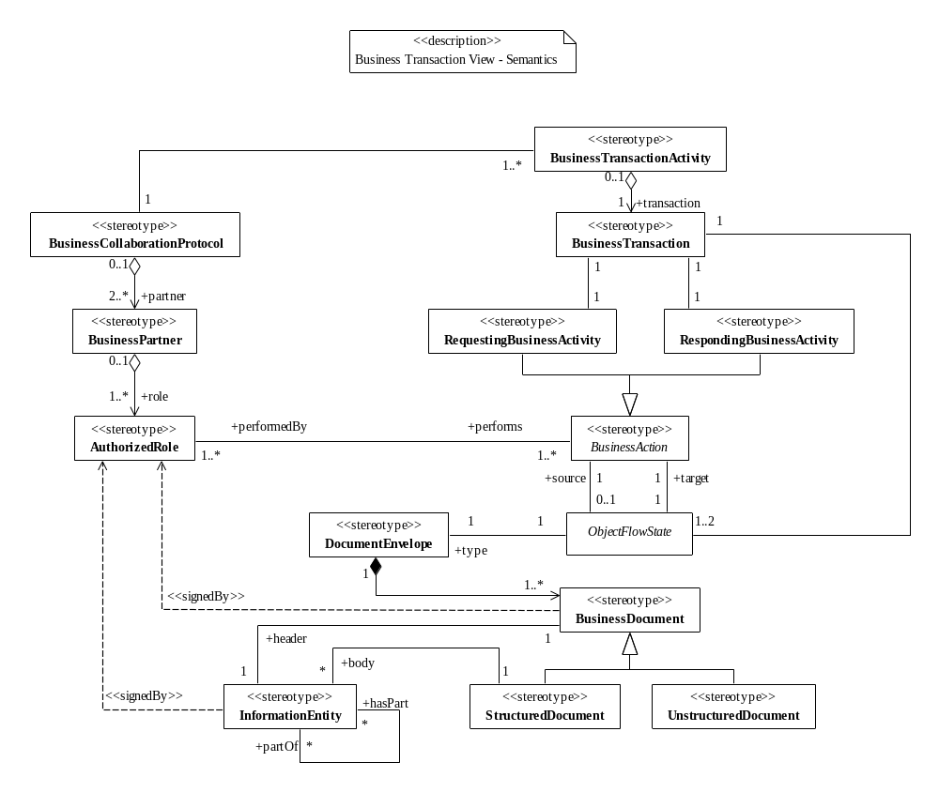
BTV Semantics

Slide 48
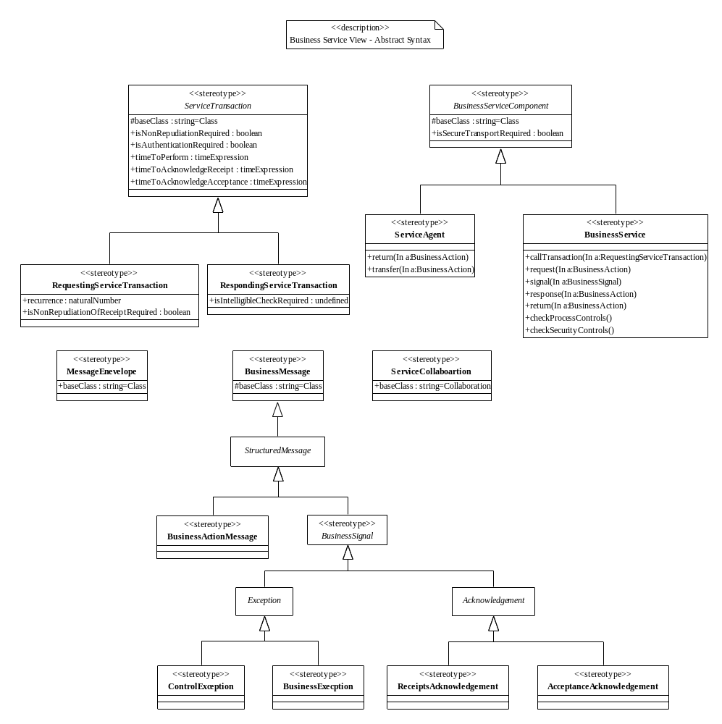
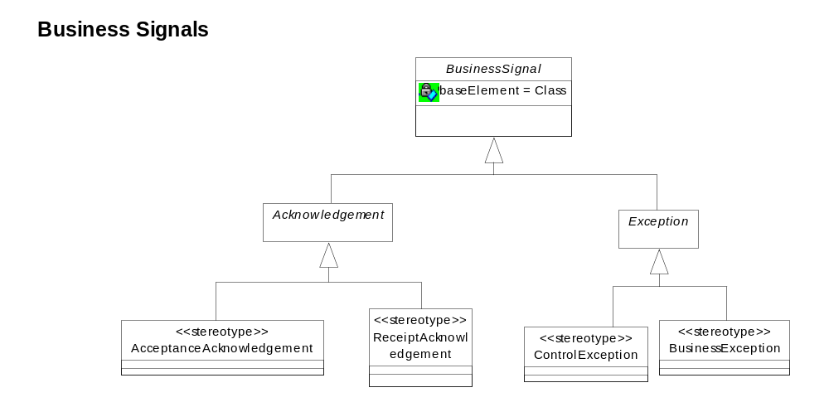
BSV Syntax

Slide 49
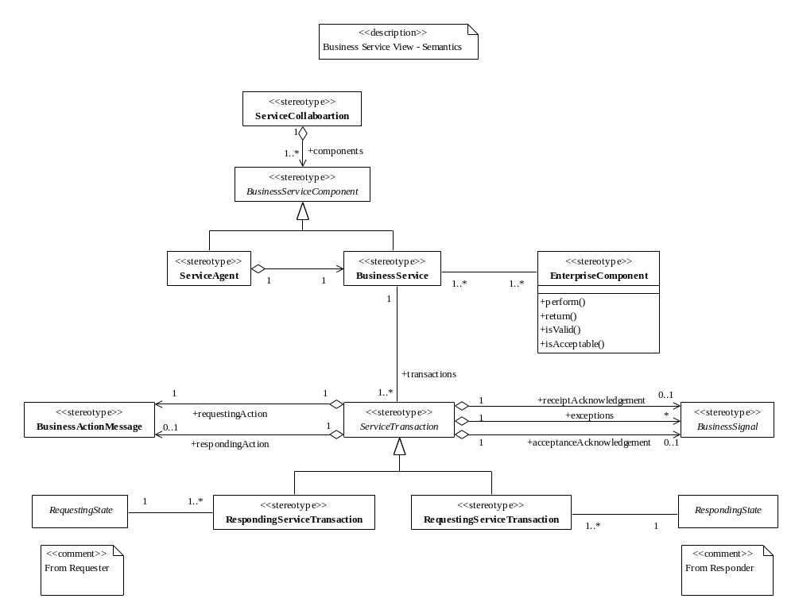
BSV Semantics

Slide 50
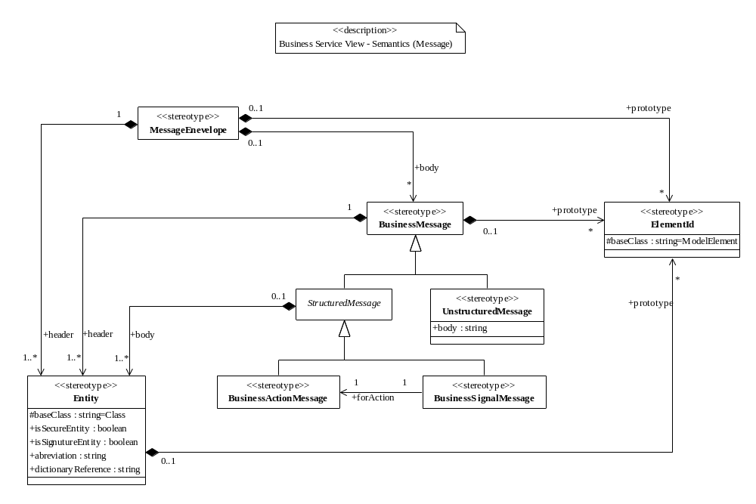
Message Semantics

Slide 51
Appendix – Detail & References
  The Commercial use of Electronic Data Interchange, Section of Business Law American Bar Association, A report and model trading partner agreement, http://www.abanet.org/buslaw/catalog/5070258.html.
  The Commercial use of Electronic Data Interchange, Section of Business Law American Bar Association, A report and model trading partner agreement: http://www.abanet.org/buslaw/catalog/5070258.html
  PART 2 UNIFORM RULES OF CONDUCT FOR INTERCHANGE OF TRADE DATA BY TELETRANSMISSION (UNCID), CHAPTER 2 - Text of the Uniform Rules of Conduct: http://www.unece.org/trade/untdid/texts/d220_d.htm
  UN/ECE RECOMMENDATION No.26, THE COMMERCIAL USE OF INTERCHANGE AGREEMENTS FOR ELECTRONIC DATA INTERCHANGE, http://www.unece.org/trade/untdid/texts/d240_d.htm

Slide 52
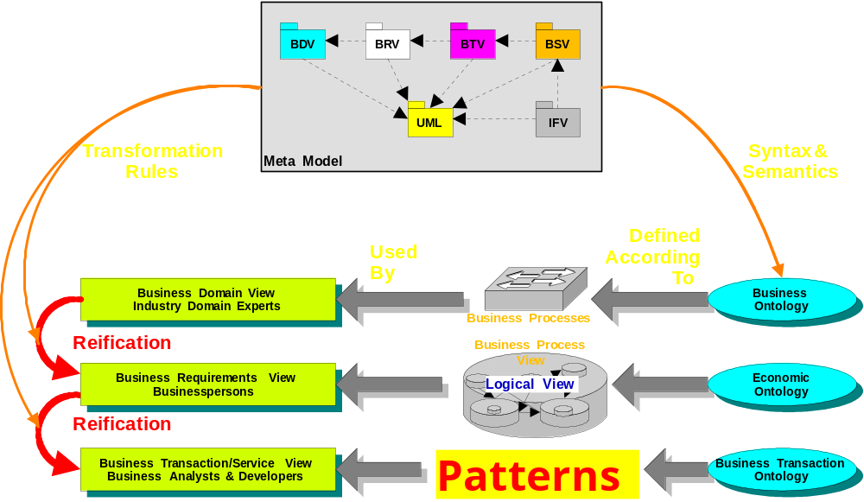
UMM Overview
Notes:
The Business Collaboration Framework architectural structure comprises a set of architectures, patterns and business semantics defined in accordance with certain business reference models and ontologies. This framework provides for the reification of process and information definition from one view or perspective to the next without the loss of semantic or computational integrity. The framework consists of 5 views, business collaboration patterns, business transaction patterns, service interaction and information patterns, as well as a well-formed meta-model which defines the syntax and semantics for each view. Uniformity of notation and precision of semantics provide concise and unambiguous business process definitions.

Slide 53
Some of the KEY concepts

Slide 54
Two ways to Orchestrate:
Technology-centric:
  Adapt computer science concepts:
    Workflow Engines, Distributed state machines, more …
Business-centric:
  Capturing the conversation of business deals:
    I commit to pay for the goods if you commit to deliver them
Both are necessary, so who rules?

Slide 55
Business already knows how to orchestrate deals
Negotiation
  Offer and Counter-offer
Offer and Acceptance
Commitment and Fulfillment
Deliver the goods and Pay for them

Slide 56
BCF Logic Chain
Business commitments are a set of expected business results
  Promise to deliver a compliant product
Fulfillment is the accomplishment of the expected business result
  Proof of delivery and product acceptance
So we organize e-Business activities to fulfill business commitments
  Quote, order, ship, receive, accept, and pay

Slide 57
The BCF
use
Business Entity States
to orchestrate
Business Collaboration Activities

Slide 58
Business Entities and States
Business Entities are the “nouns” of business deals:
  Examples: Products, Orders, Shipments, etc.
Business Entities undergo Business States
Business Entities have some of the same information elements of Business Documents exchanged between trading partners - but
they are not the same things

Slide 59
Business Entities and States
Business States are named states of Business Entities which
  affect both trading partners and which both partners must agree upon
  are milestones in the life of a business relationship
Examples: Order.accepted, Order.fulfilled, Order.cancelled, Payment.received

